Slide 1
Fair, Accountable, Transparent Machine Learning (FAccT ML) ZG517
Dr. Sugata Ghosal
sugata.ghosal@pilani.bits-pilani.ac.in

Slide 2
Session 11
Time – 10:40 AM to 12:40 PM
These slides are prepared by the instructor, with grateful acknowledgement of many others who made their course materials freely available online.

Slide 3
Outline
Post Hoc Interpretability
Proxy Models
Local Surrogate Methods
LIME
SHAP
Anchors

Slide 4
Outline
Shapley Additive Explanations (SHAP)
Coalitional Game and Shapley Values
Kernel SHAP
Tree SHAP

Slide 5
Shapley Additive Explanations (SHAP)
Assigns Feature Importance Weights Based on Game Theory
Each feature is a player
Probability P(Ŷ | X) is the total payoff
Distribute the total payoff to players (features) "fairly"
Φ₀
Φ₁
Φ₂
Φ₃
Φ₄
P(Ŷ | X)
0.6 | 0.05 | 0.03 | 0.01 | 0.01 | ΣΦ_{i} = P(Ŷ | X) | 0.7
0.1 | 0.2 | 0.3 | -0.1 | 0 |  | 0.5
0.2 | 0.1 | 0.1 | 0.2 | -0.1 |  | 0.5
0.05 | 0.10 | 0.05 | 0.1 | -0.1 |  | 0.2

Slide 6

Shapley Values
Developed by Lloyd Shapley
American mathematician
Nobel Prize-winning economist

Slide 7



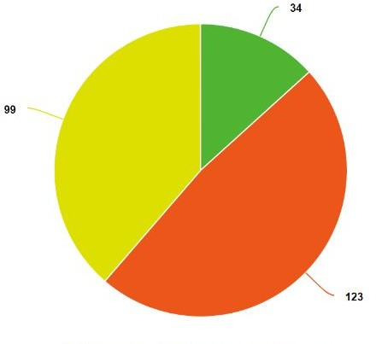
Coalitional Game
How Do We Assign Importance Scores to Players?
Consider the interactions to all other players
? ? ?
How much value should we attribute to each player?
?
v= 100
How do we account for the interactions among players?

Slide 8
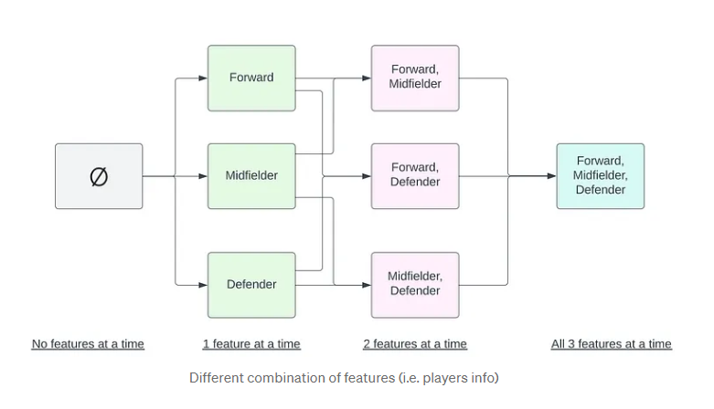
Shapley Value

Slide 9
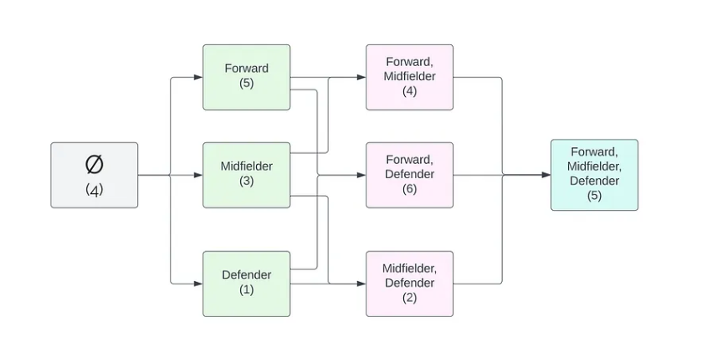
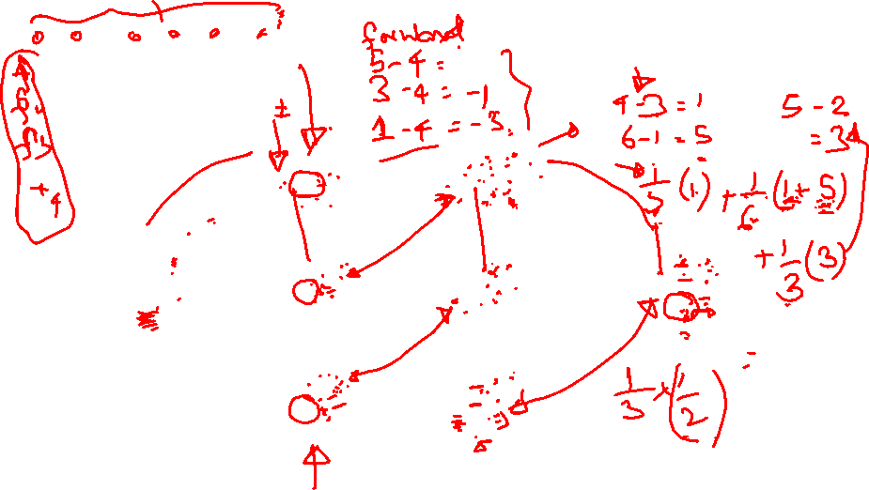

Slide 10
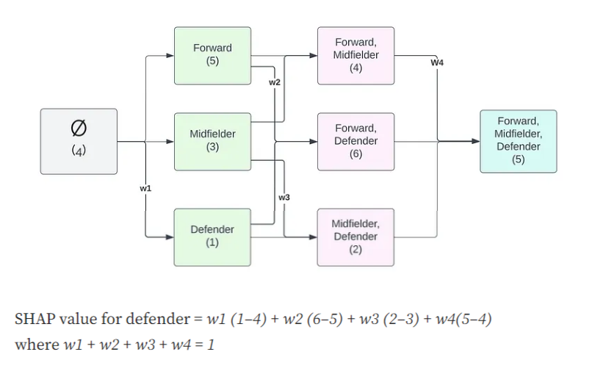

Slide 11
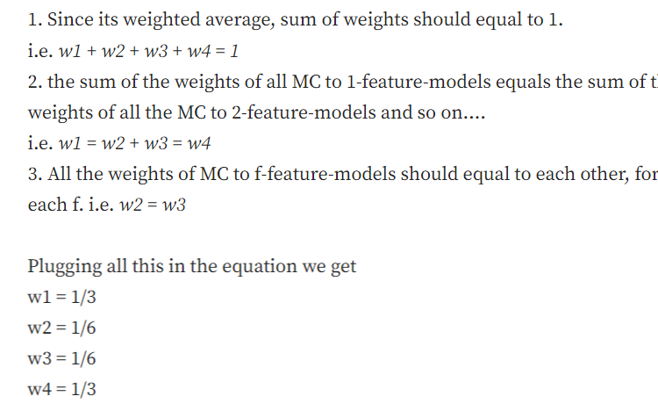
the

Slide 12



Coalitional Game
v= 150
v= 230
Players
Coalitions
Payoffs

Slide 13


Coalitional Game
v= -20
v= 230
Players
Coalitions
Payoffs

Slide 14
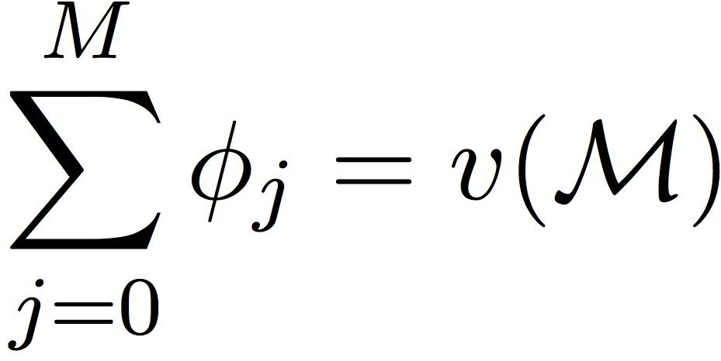
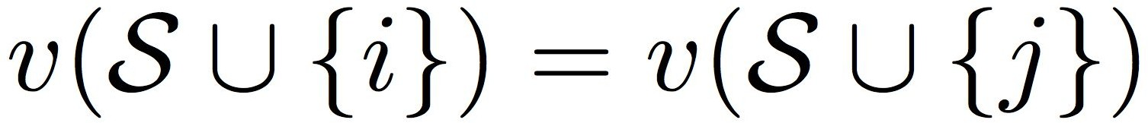
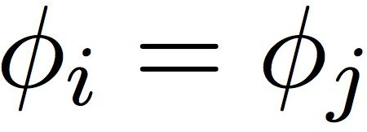



Shapley Values
Design A Value Scheme Φi for player i
M-Player coalitional game
Payoff function v(S)
Value Scheme Has to Follow Four Criteria
1) Efficiency
2) Symmetry
3) Dummy Player
4) Linearity
Aas et al, 2019

Slide 15
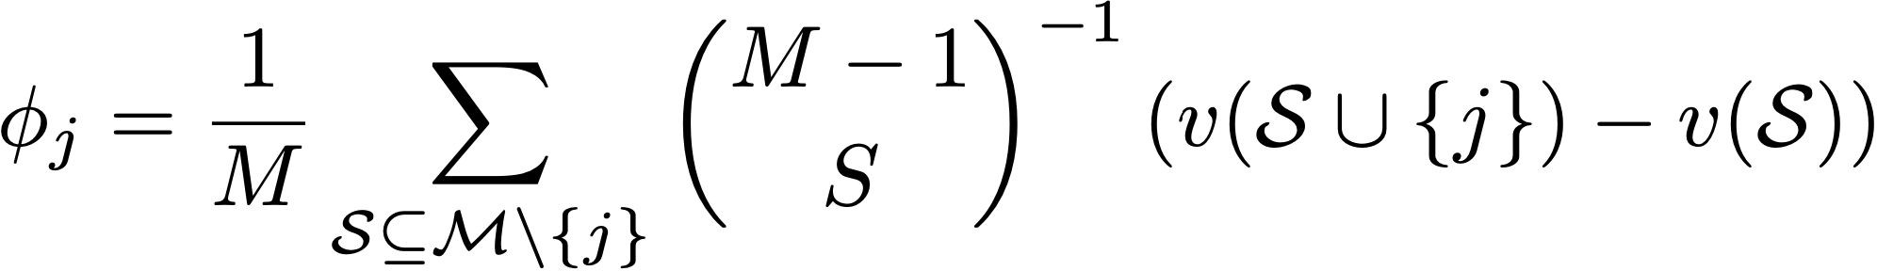
Shapley Values
Solution: Shapley Values
M - set of players
v (S) payoff function
Shapley Value for player i
normalizer
impacts to to payoffs

Slide 16

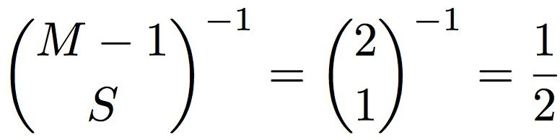


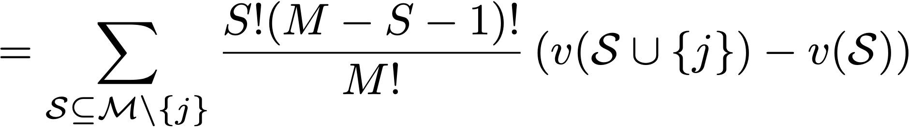
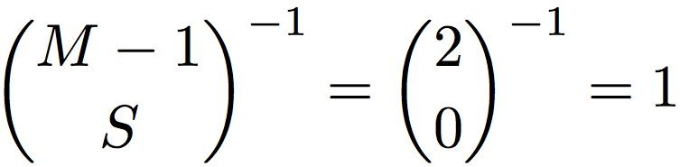
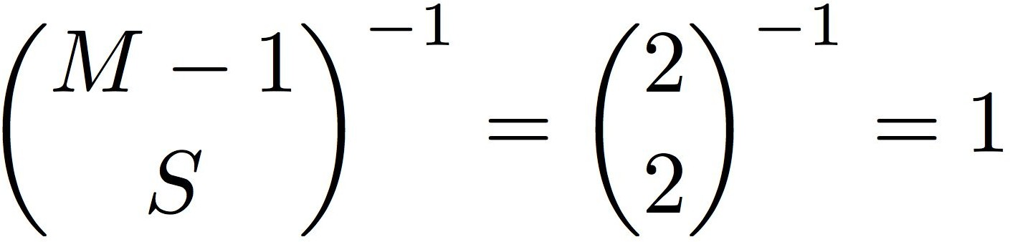
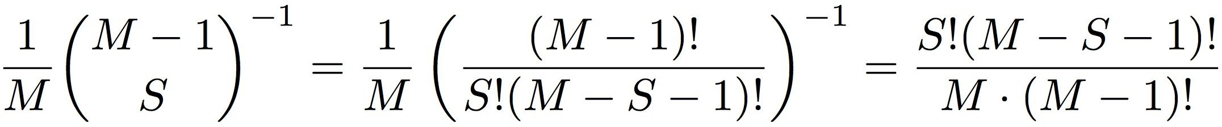


Shapley Values
Calculate Shapley Value for Player 2
1
2
3
2
?
?
2
?
1
3
2
?

Slide 17
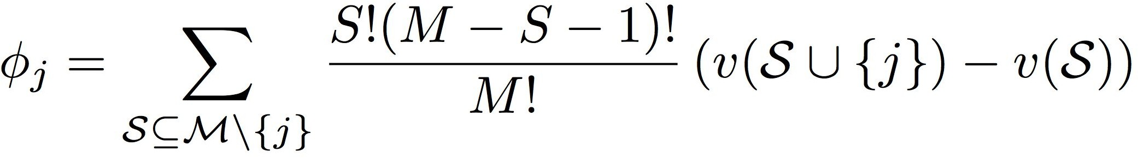
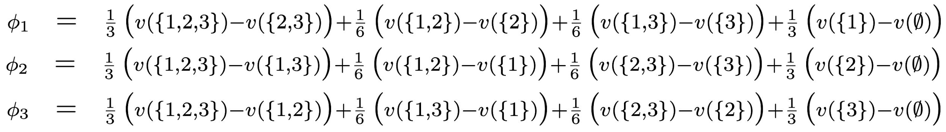
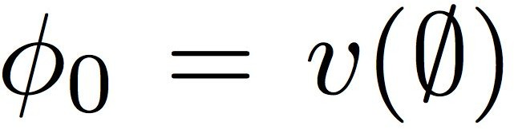
Shapley Values
1
3
2
? ?
?
Aas et al, 2019

Slide 18
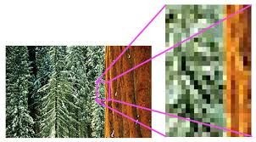

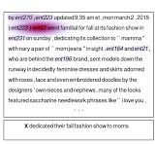
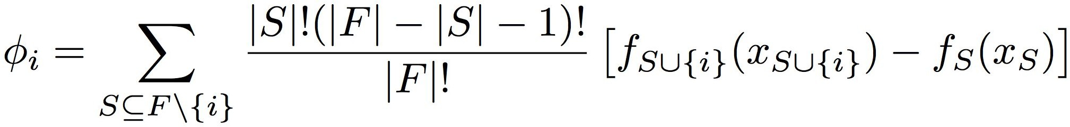
Back to ML Interpretability
SHAP
Treat each feature i as a player as if we were in a coalitional game
Estimate the value of feature i by shapley values
predictor that uses feature
value of feature i
payoffs (probability)
Lundberg et al, 2017

Slide 19
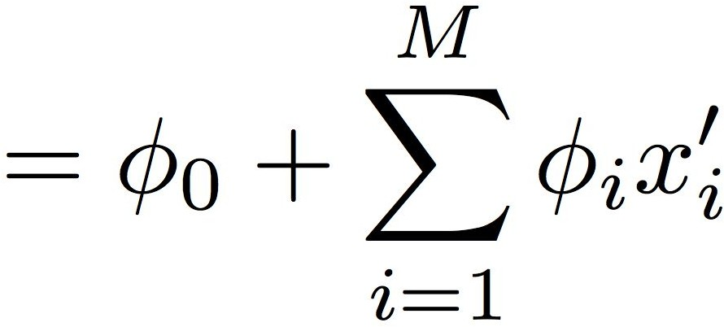
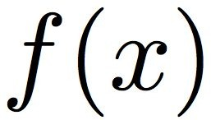
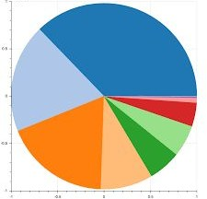
Additive Feature Attribution
feature mask
Efficiency of Shparly Values
Lundberg et al, 2017

Slide 20
Challenges with Shapley Value
The Shapley values of an ML model can be computed exactly as a weighted sum of each feature's marginal contributions.
This involves retraining the model 2^{F} times, where F is the number of features. These retrained models encompass every possible combination of features, also referred to as the power set of all possible feature coalitions.
Training so many models is usually prohibitive, so instead we must find ways to approximate this process. We explore a naive approach for approximating Shapley values that avoids model retraining.

Slide 21
SHAP Values
Generating marginalised predictions - Naive approximation approach is to use this single model for the entire power set, but for each feature that's missing in a given feature coalition, we randomly replace that feature's value with another value from the dataset. In SHAP, "removing" features using methods such as this is referred to as masking.
Replacing the value of a feature with another value sampled at random from the dataset is referred to as sampling from the feature's marginal distribution. This can result in unrealistic combinations of feature values.
More sophisticated methods will sample from the conditional distribution, which ensures that only realistic feature combinations are yielded.

Slide 22
Computational Challenges
Terms Grow In the Order of 2^{F}
Approximating Solutions
Shapley Sampling Values (Štrumbelj et al, 2013)
Tree SHAP (Lundberg et al, 2018)
Deep Approximate Shapley Propagation (Ancona et al, 2019)

Slide 23
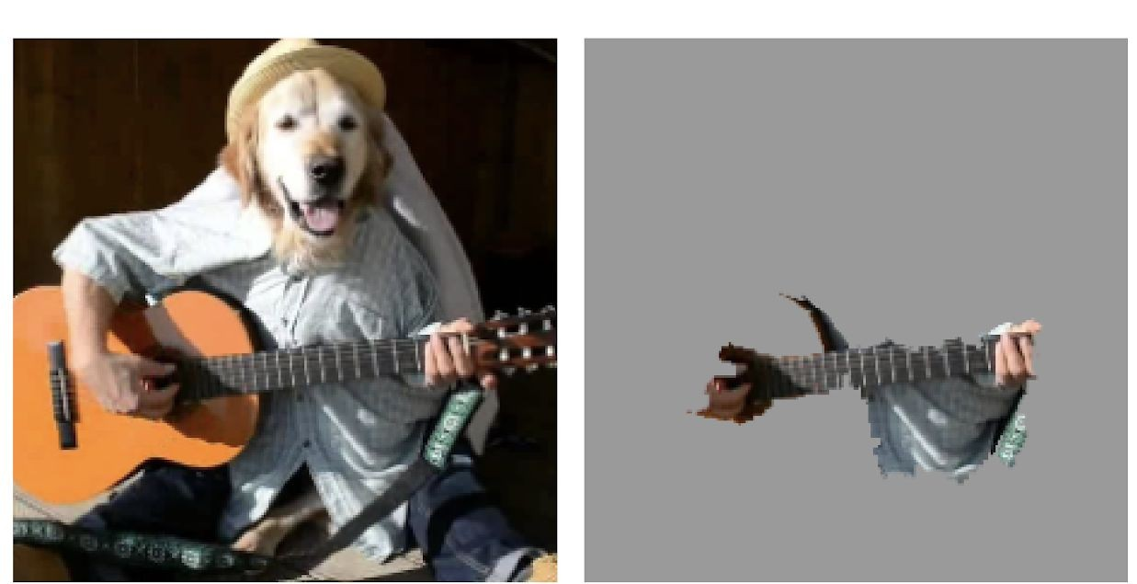
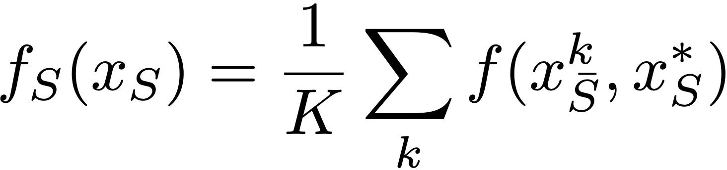
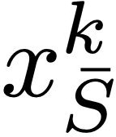
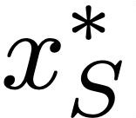
Computational Challenges
Estimating Prediction Outcomes With Partial Features
Neural networks are not designed to use partial features
One solution is to use the expected value (Lundberg et al, 2018)

Slide 24
SHAP Based Methods
SHAP
model agnostic
linear composition model
tree based models
Kernel SHAP
Deep SHAP
Tree SHAP
Equivalent to LIME
Equivalent to DeepLift, LRP

Slide 25
KernelShap
Assume the trained model f(x1, x2, , , xM) has M=4 features
we investigate on data instance x for example x = (10,20,30,40)
1.Generate a vector which has M elements, and each element is randomly choose as 0 or 1. We use z′ represent the vector, so one random example can be z′ = (1,0,1,0). Here 1 indicates the presence of the feature, while 0 indicates the feature missing.
Totally we can generate 2^M different z′.
Finally our mapping example result is h(z′) = (10, 22, 30, 44), 10 and 30 from instance x, 22 and 44 are randomly sampled values.
Note: the mapping h(z′) is a one-to-many mapping, the max number of output mapping is the size of the given dataset if missing feature sampling is based on marginal distribution.
3.Calculate the model prediction f(h(z′)).

Slide 26
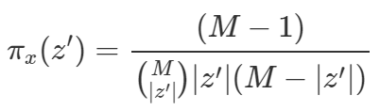
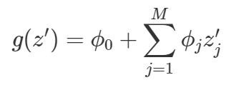
4.Compute the weight for each z′ with the below SHAP kernel (the intuition for the kernel will be discussed in next section, let’s go ahead)
5. Construct the below linear regression model g(z′), the coefficient φ0 represents model’s average prediction on all data instances, and φ1, φ2, , , φM represent
corresponding feature’s contribution.

Slide 27

KernelSHAP introduces the below custom loss function, and the custom loss function actually is MSE loss weighted by kernel π(z′)

Slide 28
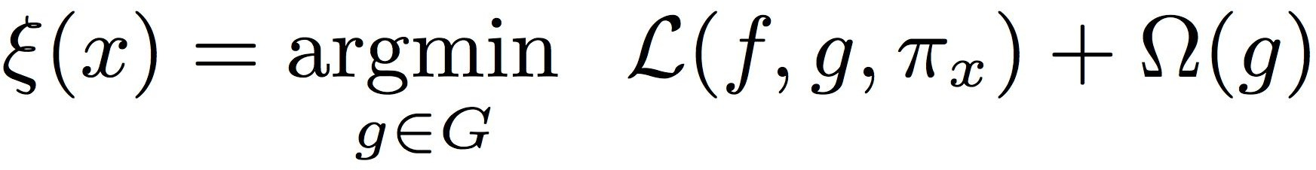
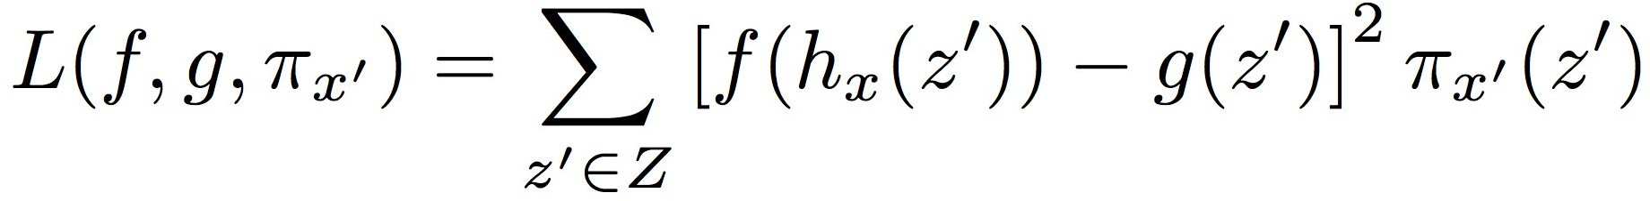

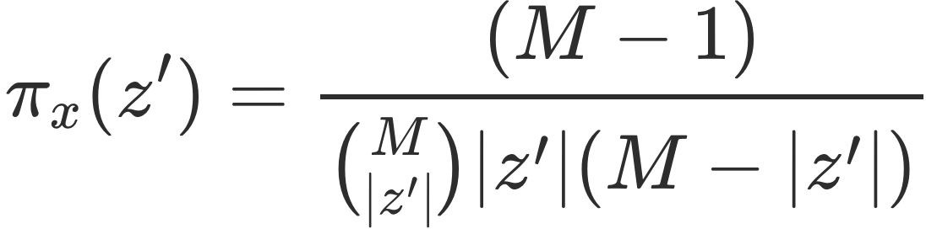
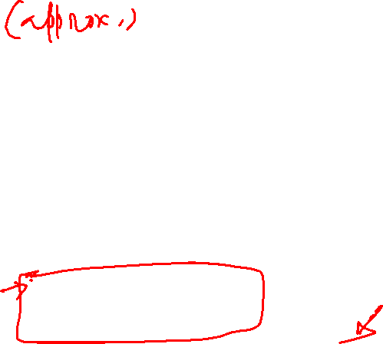
Kernel SHAP
Remember the LIME Training Objective
SHAP Equivalent Objective
Lundberg et al, 2017

Slide 29
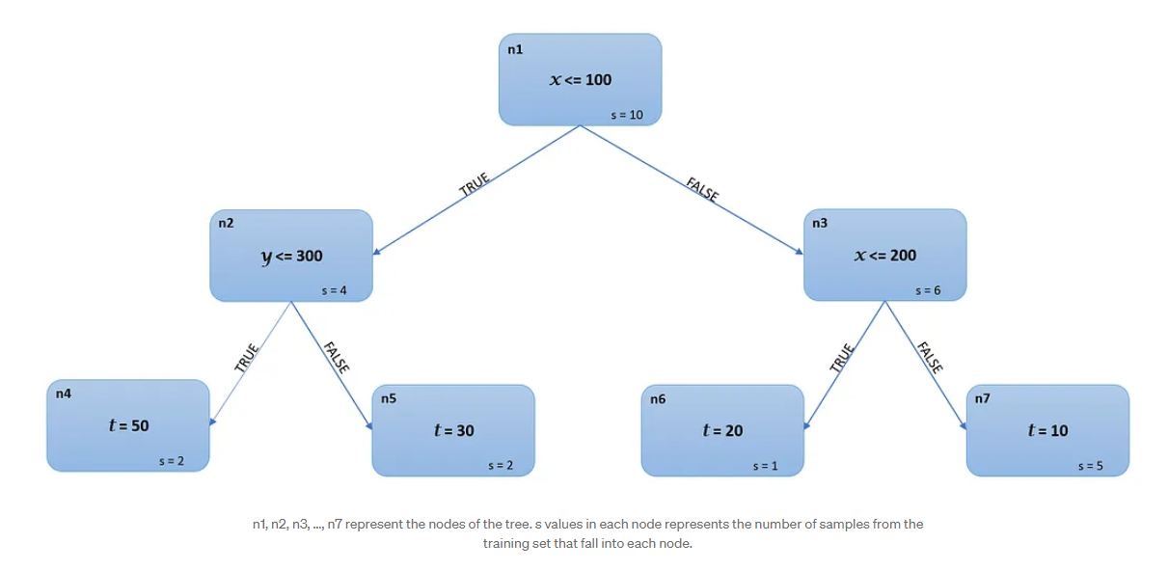
TreeShap
compute the SHAP values for
[x=150, y=75, z=200]

Slide 30
The prediction for the null model ϕ⁰ (also called base value)= mean prediction for the training set = (50*2 + 30*2 + 20*1 + 10*5)/10 = 23
Consider the sequence: x > y > z:
Marginal contribution of x in this sequence, ϕˣ¹= 20–23 = -3.
Marginal contribution of y and z in this sequence ϕʸ¹ = ϕ^{z}¹ =20–20 = 0

Slide 31
Let’s consider the sequence y > z >x:
Point of interest: [x=150, y=75, z=200]
1)First, the feature y is added to the null model. The first node n1 uses x as the split variable, since is x is not available yet, we compute the prediction as (4/10)*(prediction from left child node n2) + (6/10)*(prediction from right child n3)
Prediction from node n2: n2 uses y as the split variable, since y is available (yᵢ = 75 for instance i), the prediction from node n2 = 50.
Prediction from node n3: Again, n3 uses x as the split variable. Therefore, by similar logic, prediction from n3 = (1/6)*20 + (5/6)*10= 70/6.
Therefore, the prediction for the model with just the feature y is (4/10)*50 + (6/10)*(70/6) = 27.
iv) Hence, the marginal contribution for y in this sequence, ϕʸ² = 27–23 = 4.
2) Marginal contribution for z in this sequence, ϕᶻ² = 0.
3)Finally, we add the feature x to the model which gives the prediction as 20. Therefore the marginal contribution of x in this sequence is ϕˣ²=20–27 = -7.

Slide 32

Sequence x > z > y: ϕˣ³ = -3, ϕʸ³ = 0, ϕᶻ³ = 0
Sequence z > x > y: ϕˣ⁴ = -3, ϕʸ⁴ = 0, ϕᶻ⁴ = 0
Sequence z > y> x: ϕˣ⁵ = -7, ϕʸ⁵ = 4, ϕᶻ⁵ = 0
Sequence y > x> z: ϕˣ⁶ = -7, ϕʸ⁶ = 4, ϕᶻ⁶ = 0
Hence, SHAP values for the instance i are given by:
ϕˣ = (ϕˣ¹ + ϕˣ² + ϕˣ³ + ϕˣ⁴ + ϕˣ⁵ + ϕˣ⁶)/6 = (-3–7–3–3–7–7)/6 = -5
ϕʸ = (ϕʸ¹ + ϕʸ² + ϕʸ³ + ϕʸ⁴ + ϕʸ⁵ + ϕʸ⁶)/6 = (0+4+0+0+4+4)/6 = 2
ϕᶻ = (ϕᶻ¹ + ϕᶻ² + ϕᶻ³ + ϕᶻ⁴ + ϕᶻ⁵ + ϕᶻ⁶)/6 = (0+0+0+0+0+0)/6 = 0
Explanation for the prediction for instance i (20) = ϕ⁰ + ϕˣ + ϕʸ + ϕᶻ = 23 + (-5) + 2 + 0 = 20:
“The base value of the prediction in the absence of any information on independent variables is 23; knowing x=150 decreased the prediction by 5 and knowing y = 75 increased the prediction by 2 giving a final prediction of 20. Knowing z = 300 had no impact on the model prediction.”

Slide 33
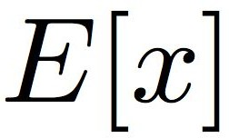
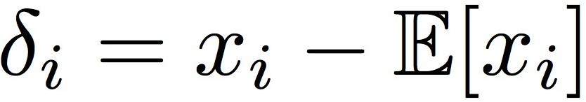
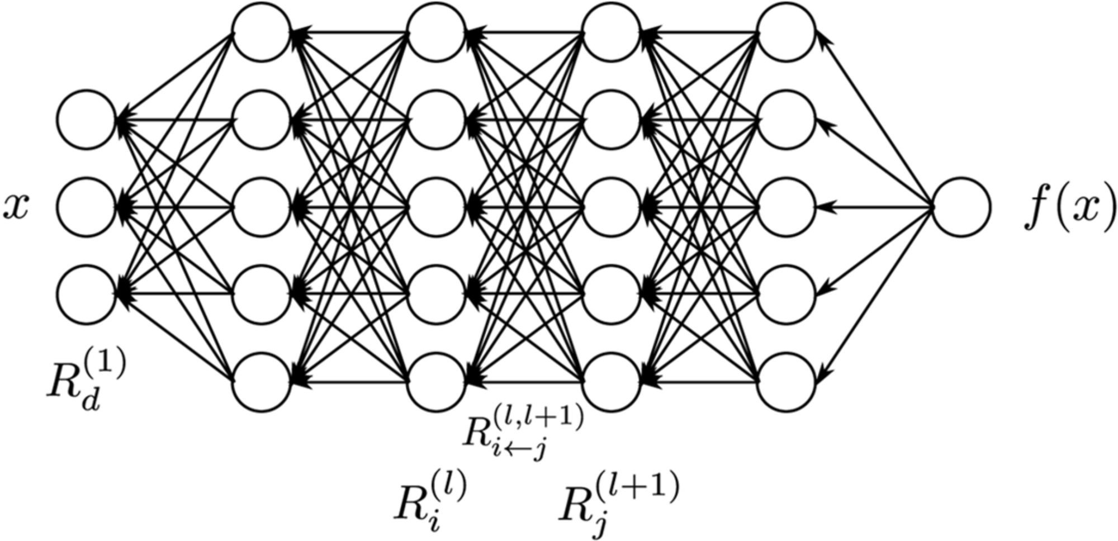














































Deep SHAP
Incorporate Shapley Values Into Linear Composition Model
DeepLift approximates Deep SHAP when the reference value is taken to be
Lundberg et al, 2017

Slide 34
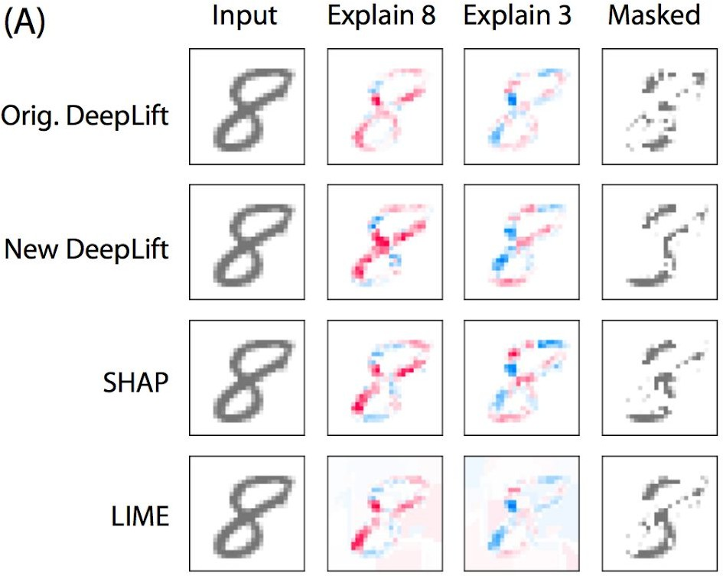
Feature Importance for MNIST

Slide 35
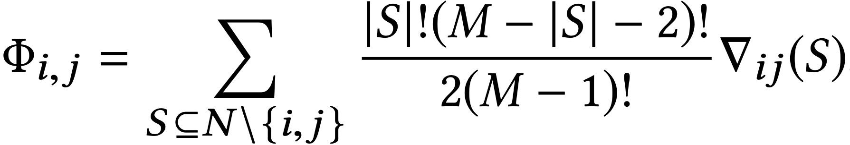
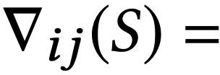
SHAP Interaction Values
Pairwise Interactions of Shapley Values
Shapley Values

Slide 36
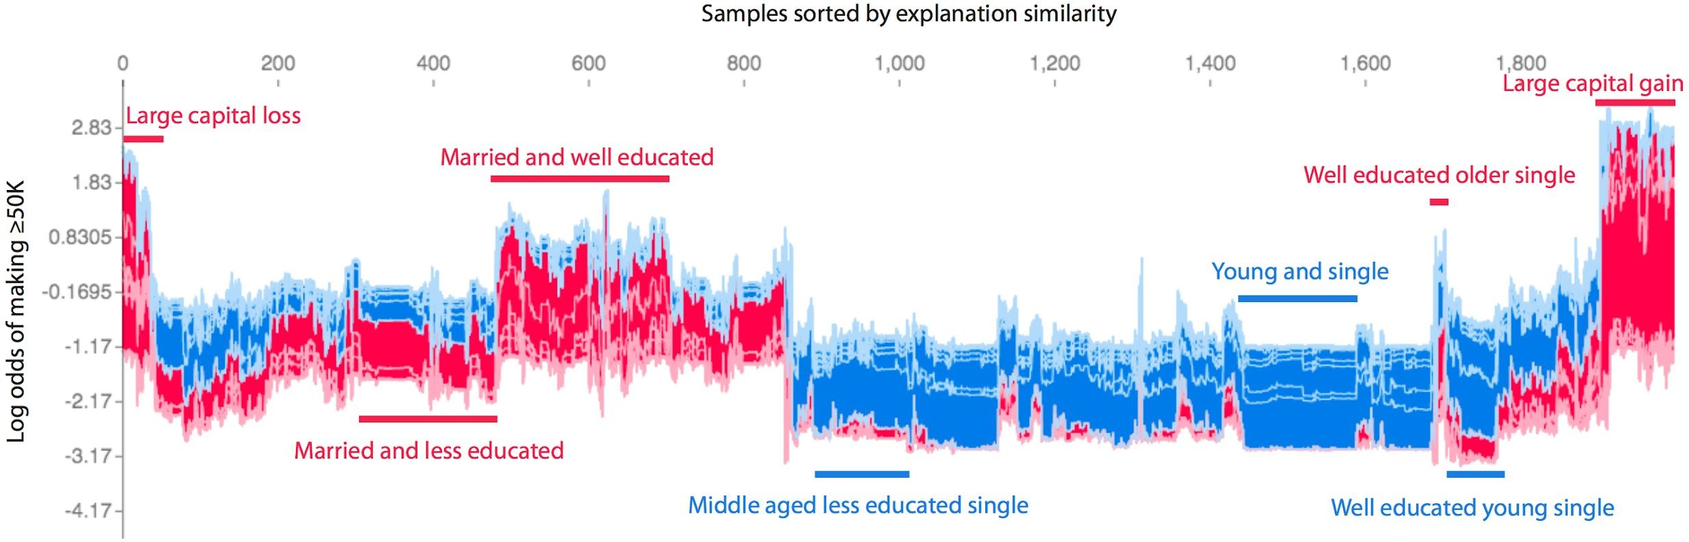
Adult Income
Samples are clustered using the ordering in the leaf nodes
Lundberg et al, 2018

Slide 37
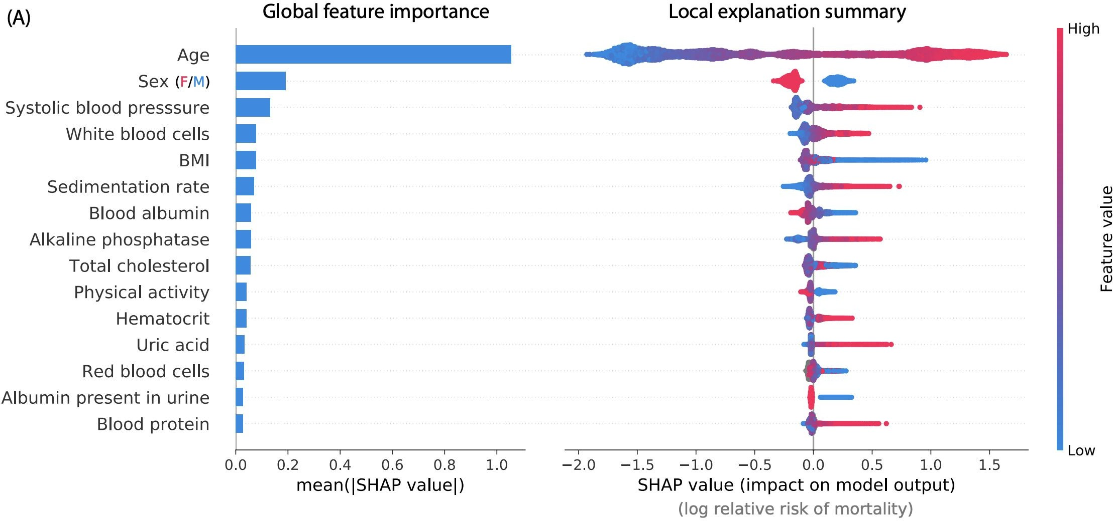
Mortality Data
Survival model on 20 year mortality followup data
14,407 individuals and 79 features
Lundberg et al, 2019

Slide 38
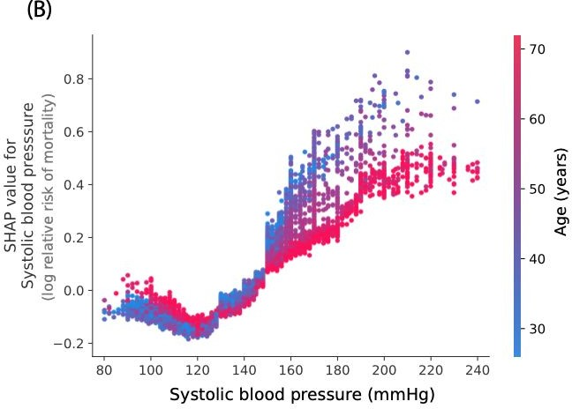
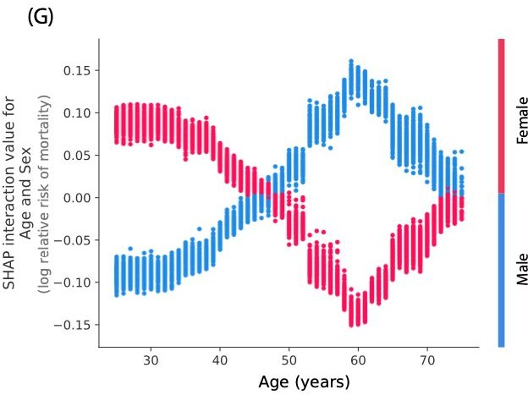
Mortality Data
Shapley Values
Shapley Interaction Values
Lundberg et al, 2019

Slide 39
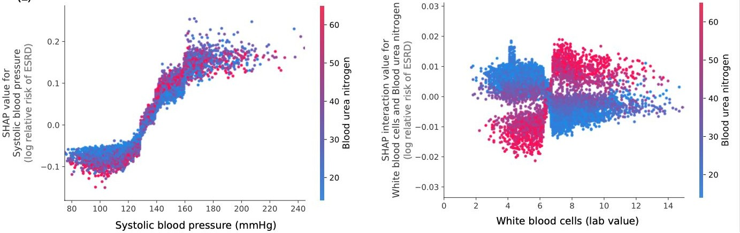
Chronic Kidney Disease
Shapley Values
Shapley Interaction Values
Lundberg et al, 2019

Slide 40
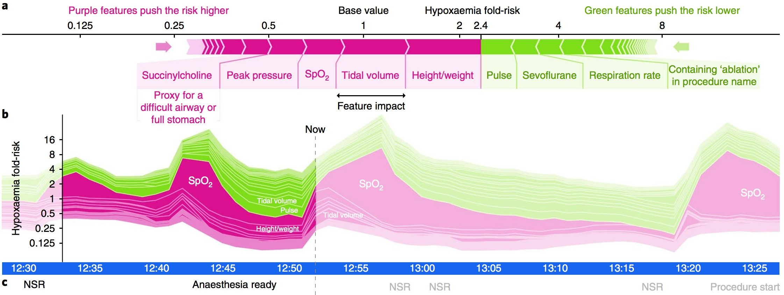
Predicting Hypoxaemia During A Surgery
Hypoxaemia
An abnormally low amount of oxygen in the blood
Lundberg et al, 2018

Slide 41
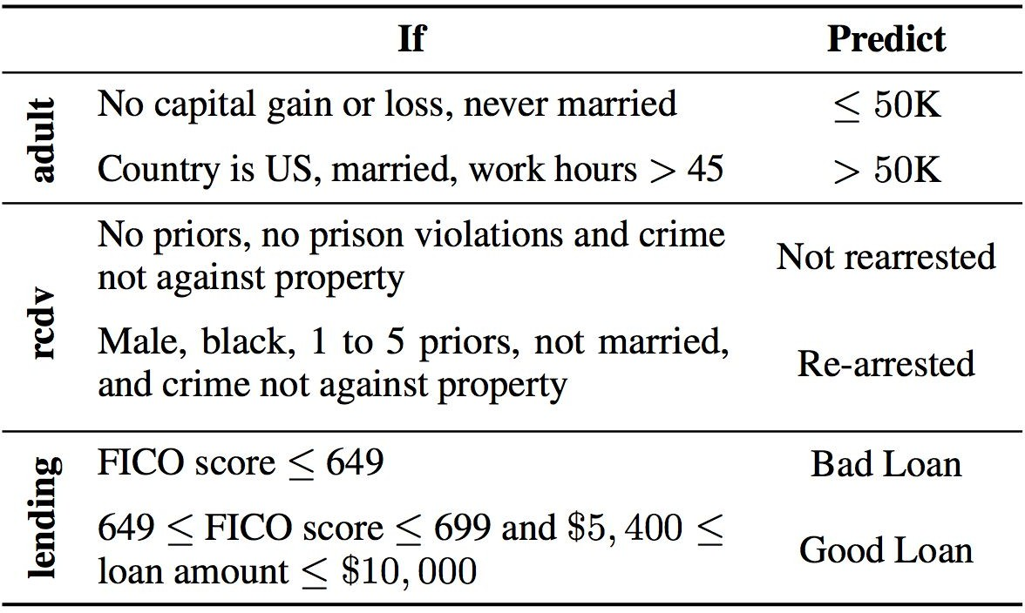
Rule Based Explainers
Explain the Predictions of Deep Learning Models Using Rules
How do we find the set of rules for a particular predictor?
Ribeiro el al, 2018

Slide 42
Anchors
Generate A Set of Feature Predicates Known as Anchors A (i.e., rules)
Using anchors to explain the performance of deep model f
mimic the decisions of deep models on x, f(x)
explain a wide range of similar decisions in the dataset
Ribeiro el al, 2018
Anchors found in adult income dataset

Slide 43
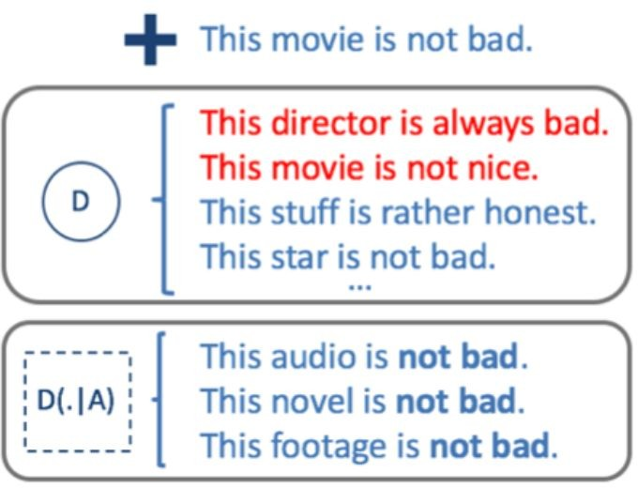
Anchors
An Anchor is a set of feature predicates applied to the feature space
A = {“not”, “bad”}
Any text sample x containing both "not" and "bad" will be selected by the anchor A(x) = 1
An anchor can be applied to a dataset D to generate a subset D(.|A)
A = {“not”, “bad”} Samples in a data set D
Samples selected by Anchor A
Ribeiro el al, 2018

Slide 44
Formal Definitions of Anchors
Preconditions of Anchors
Applies to the sample x being interpreted
Precisions
Samples covered by the same anchor A need to have the similar predictions
i.e., f(x)=f(z) for z~D(.|A)
Coverage
A significant portion of the data needs to be covered by Anchor A.
Anchor generated from x= "This movie is not bad. "
same predictions f(x)=f(z)
Ribeiro el al, 2018

Slide 45

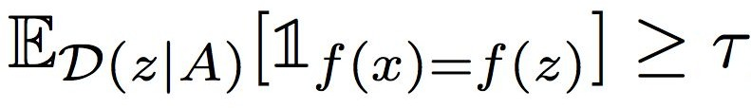

Formal Definitions of Anchors
Preconditions of Anchors
Applies to the sample x being interpreted
Precision
Samples covered by the same anchor A need to have similar predictions
Coverage
A significant amount of data needs to be covered by one anchor A.
Ribeiro el al, 2018

Slide 46

Anchors for Part of Speech Tagging
Ribeiro el al, 2018

Slide 47


Anchors for Machine Translation
Group Predictions of Words with Similar Meanings
"esta" (feminine of word "this")
"este" (masculine of word "this")
"isso" (if its referent is not in the sentence)
Ribeiro el al, 2018

Slide 48

Anchors for Image Classification (InceptionV3)
original image
Anchors for "beagle"
Ribeiro el al, 2018

Slide 49



Anchors for Visual Question Answering (VQA)
Anchor for predicting "dog"
Other Anchors
Ribeiro el al, 2018

Slide 50



Generating Anchors
Preconditions
Precision
Coverage
Challenges in Generating the Optimal A
Calculating precision and coverage is computationally intensive
will need to iterate through the predictions of f over the entire dataset
Usually difficult to apply white box optimization techniques (e.g., gradient descent)
Ribeiro el al, 2018

Slide 51
Generating Anchors
Optimization Target
Searching for the Optimal A
for each step t,
1) Construct a set of candidate solutions with the best coverage
Candidate solutions need to satisfy cov(A) ≥ c
2) Pick top-k candidates with the best precision
Candidates need to have prec(A) ≥ τ with confidence at least 1-δ
3) Update the optimal Anchor A*
Ribeiro el al, 2018

Slide 52






Generating Anchors - Optimizing Coverage
Searching for the Optimal A
temperature
salary
heart beat
1) Optimizing coverage with cov(A) ≥ c
2) Optimizing precision with prec(A) ≥ τ and confidence at least 1-δ
3) Update the optimal solution A*
Optimizing Coverage
120 BPM | 101 F | $20,000
80 BPM | 104.4 F | $40,000
140 BPM | 99 F | $800,000
Start with
Expand
= ∅
by one element to get
+ temperature
cov(A) <c
{heart rate}
{temperature}
{heart rate, temperature}
cov(A) ≥ c
cov(A) ≥ c
+ salary
{heart rate, salary}
{temperature,salary}
{heart rate, salary}
{temperature,salary}
+ salary
Ribeiro el al, 2018

Slide 53
Generating Anchors - Optimizing Precisions
Searching for the Optimal A
1) Optimizing coverage with cov(A) ≥ c
2) Optimizing precision with prec(A) ≥ τ and confidence at least 1-δ
3) Update the optimal solution A*
Optimizing Precisions
Formulate it as a Multi-armed bandit optimization problem
Ribeiro el al, 2018

Slide 54


Multi-Armed Bandit Problem
Reward Distribution of Each Arm

Slide 55


Exploration and Exploitation Trade-offs

Slide 56
Generating Anchors - Optimizing Precisions
Searching for the Optimal A
1) Optimizing coverage with cov(A) ≥ c
2) Optimizing precision with prec(A) ≥ τ and confidence at least 1-δ
3) Update the optimal solution A*
Optimizing Precisions
Formulate it as a Multi-armed bandit optimization problem
Find out candidates with Prec(A) ≥ τ
Using minimal costs (number of pulls of the arms)
Each candidate solution A is an arm
Prec(A) of a single sample is the latent reward
Ribeiro el al, 2018

Slide 57
Generating Anchors - Optimizing Precisions
Searching for the Optimal A
1) Optimizing coverage with cov(A) ≥ c
2) Optimizing precision with prec(A) ≥ τ and confidence at least 1-δ
3) Update the optimal solution A*
Optimizing Precisions
Formulate it as a Multi-armed bandit optimization problem
Find out candidates with Prec(A) ≥ τ
Using minimal costs (number of pulls of the arms)
Each candidate solution A is an arm
Prec(A) of a single sample is the latent reward
Return the top K arms (i.e., A) with the highest reward (Prec(A)) that satisfies conditions
Prec(A) ≥ τ, P(Prec(A) ≥ τ) ≥ 1-δ
Ribeiro el al, 2018

Slide 58
Generating Anchors - Update Optimal A*
Searching for the Optimal A
1) Optimizing coverage with cov(A) ≥ c
2) Optimizing precision with prec(A) ≥ τ and confidence at least 1-δ
3) Update the optimal solution A*
Update A*
For the top-k A returned in step 2)
Find the best A* based on the Coverage criteria
Loop into the next step
Ribeiro el al, 2018

Slide 59

Precision and Coverage
Precision
Coverage
Limes
lime-n - Naive LIME algorithm
lime-t - Make predictions only when its predictive probability is above a threshold
logistic: logistic regression, gbt: gradient boosted trees
nn: two layers of 50 units MLP
Ribeiro el al, 2018

Slide 60

User Study
Ask Users to Guess the Outcomes of A ML Model After Explanations
Human annotators are 26 students who took a machine learning course
Calculate precision and coverage of the users' performance
Human mark "I don't know" when they are not certain, which makes coverage the perceived one.
LIME(n): results after n LIME explanations Anchor(n): results after n Anchor explanations
Ribeiro el al, 2018

Slide 61

User Study Results
Coverage change with number of explanations seen by the same user.
gradient boosted trees(gb)
SP - Submodular Pick
RP - Random PIck
Ribeiro el al, 2018

Slide 62


Comparisons to LIME
 | LIME | Anchors
Explanations |  | Anchors A
Optimization Target

Slide 63


Comparisons to LIME
Ribeiro el al, 2018

Slide 64


Overly Specific Anchors
Ribeiro el al, 2018

